Slide 1
**** Designing an App Part 2 ****
Lesson 3.3a

Slide 2
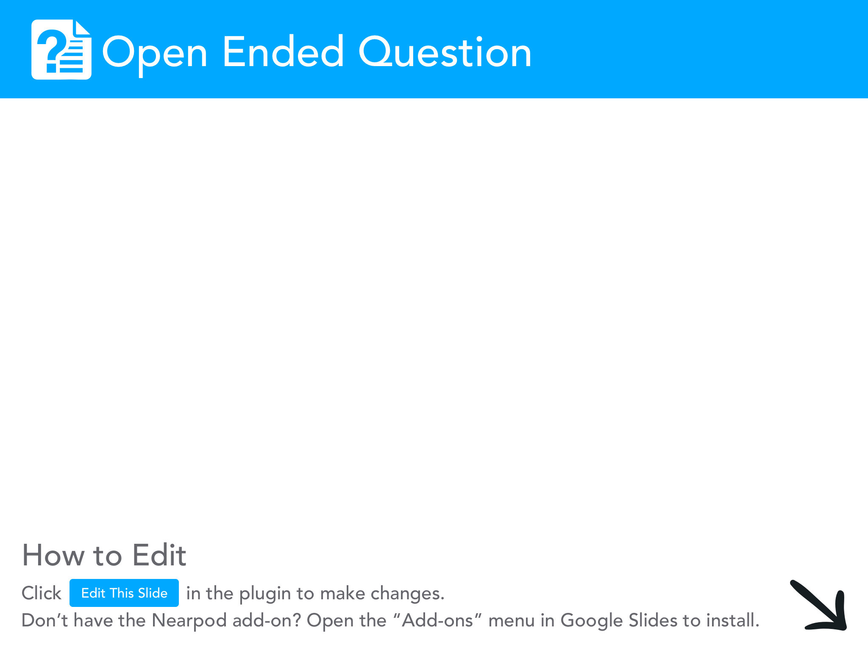
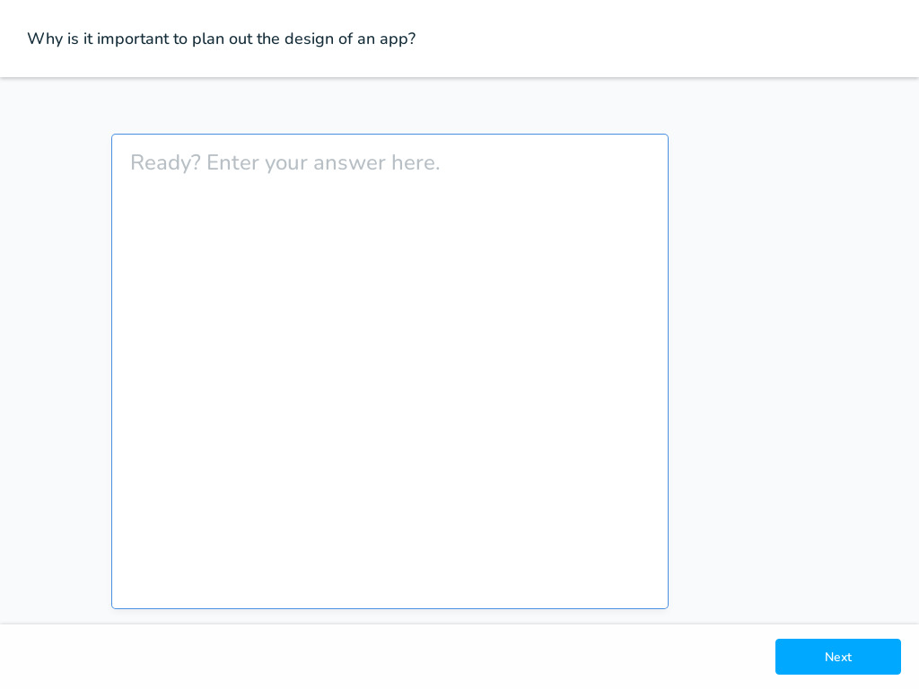

Slide 3
Prototyping
The design you sketched out for your app is a prototype of your app. A prototype helps you plan the looks and features of your app before you program it.
There are entire programming environments dedicated to just laying out the screens for an app.
It's important to remember that other people will be using your app and need to understand how to use it. A prototype can really help.

Slide 4
Head over to code.org, Unit 3, Lesson 3
You'll see a prototype of one of the apps you explored before.
After looking at this app and the prototype, you may want to make a few adjustments to your own prototypes. Take a few minutes to update your design.
When you are finished, move on to Level 2 where you will start creating your user interfaces in App Lab!

Slide 5
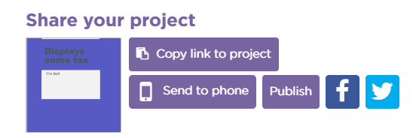

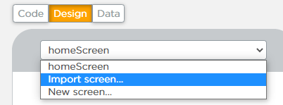
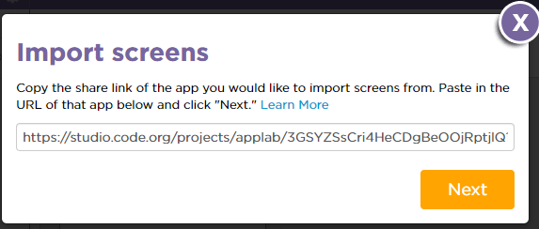
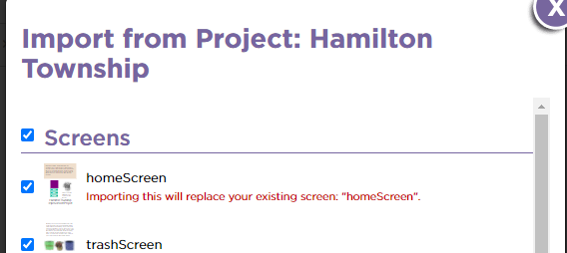
Combining Screens
Here's how to combine your screens with your partner:
Partner A should click on Share then copy the share link for Partner B.
Partner B clicks the screen dropdown, then clicks "Import screen".
Paste in the share link from Partner A.
Partner B select to import all of the screens and assets.
Partner B set the home screen to be the default screen (Hint: Go to design mode and click on the screen)
Repeat so both partners have copies of all the screens.

Slide 6
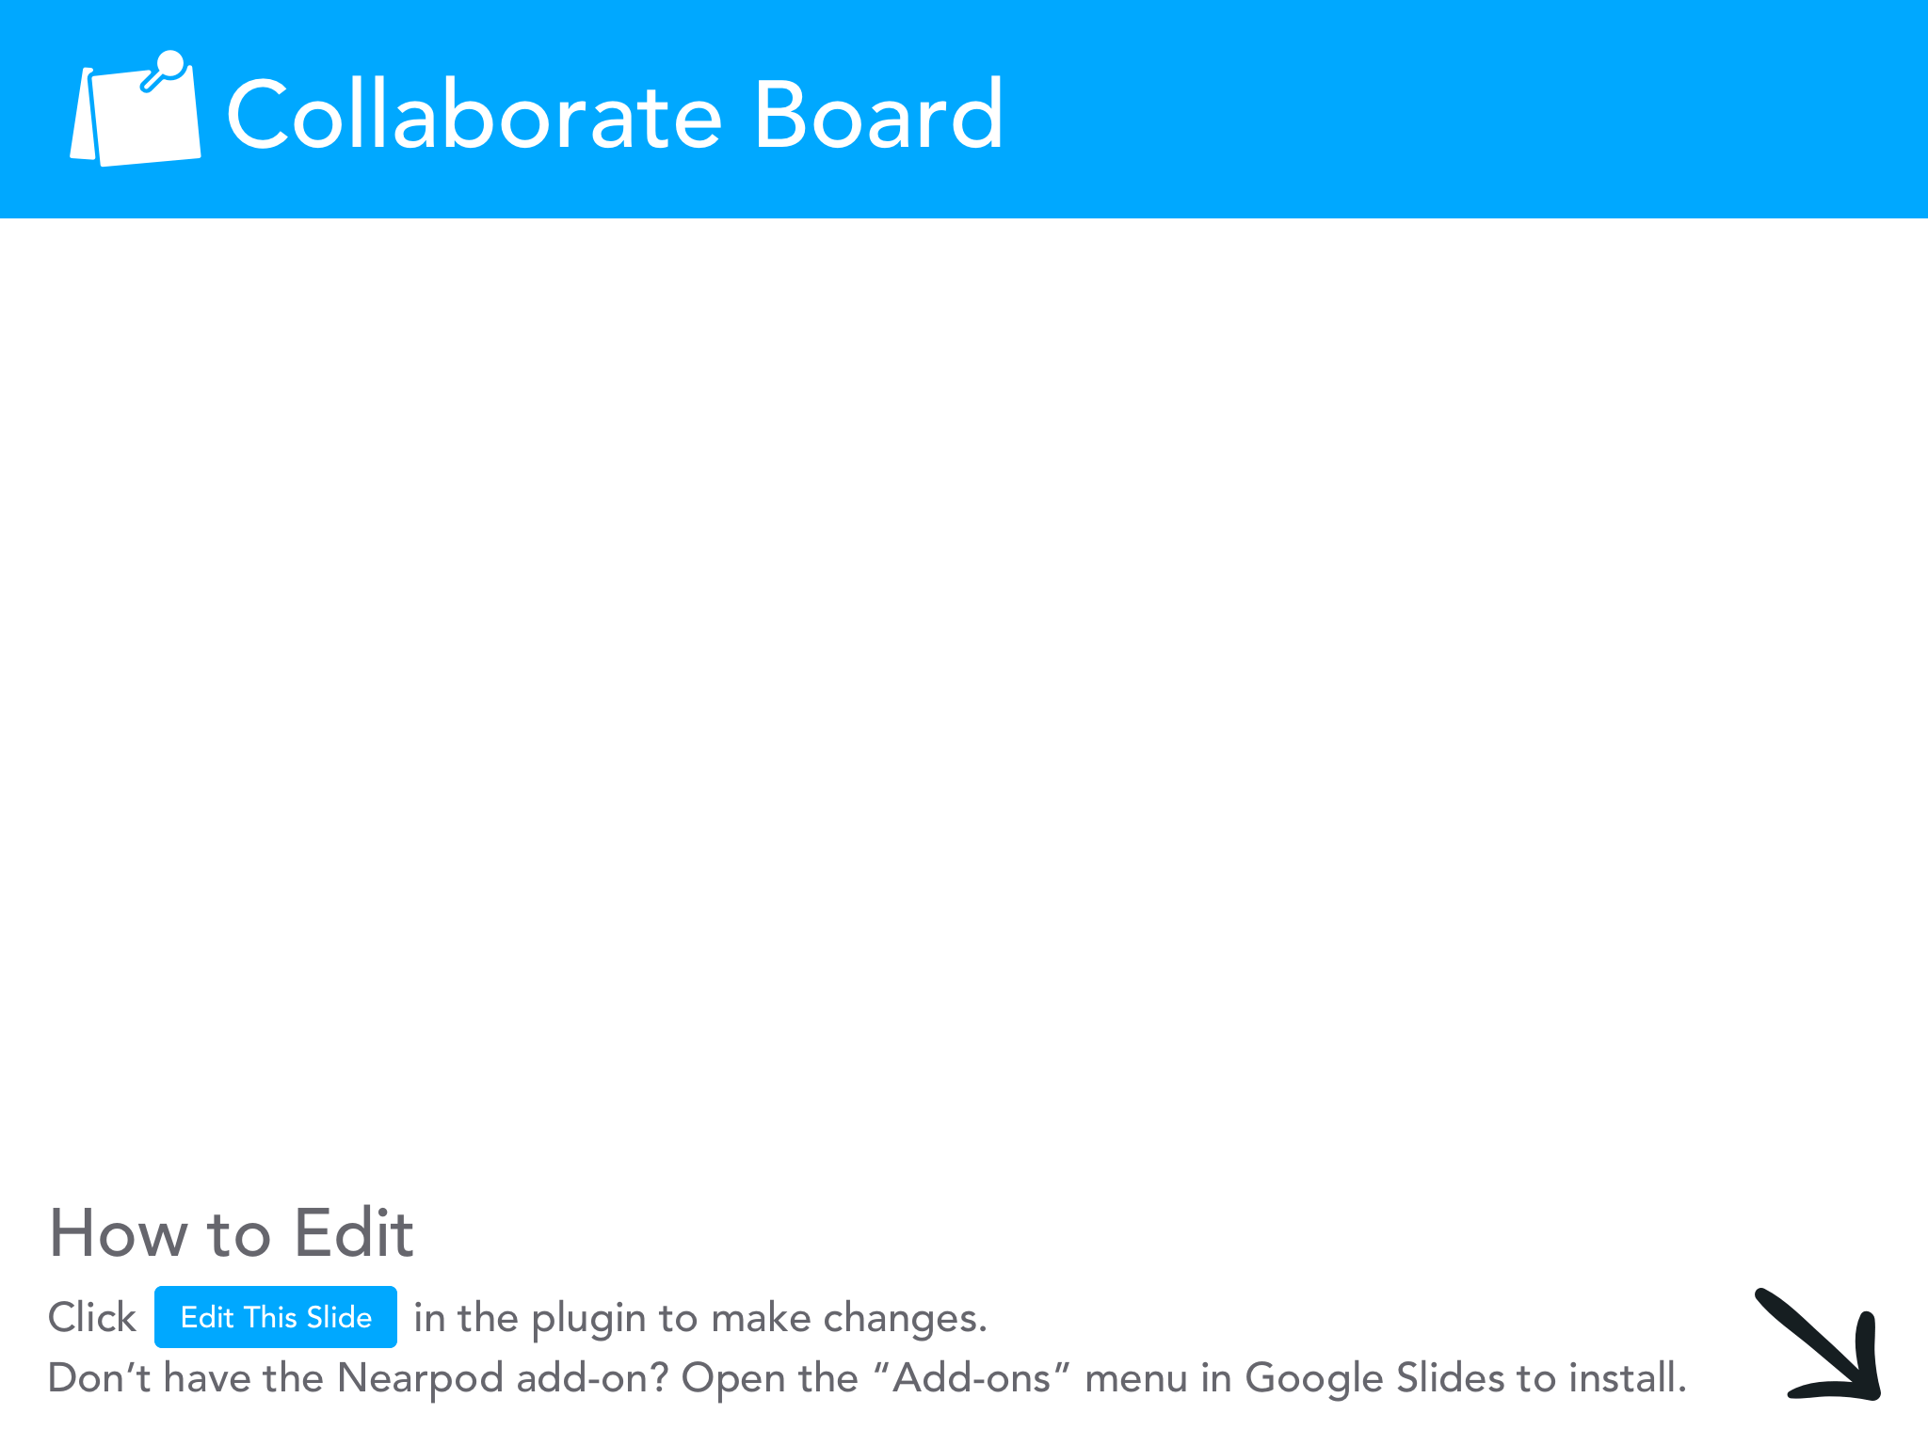
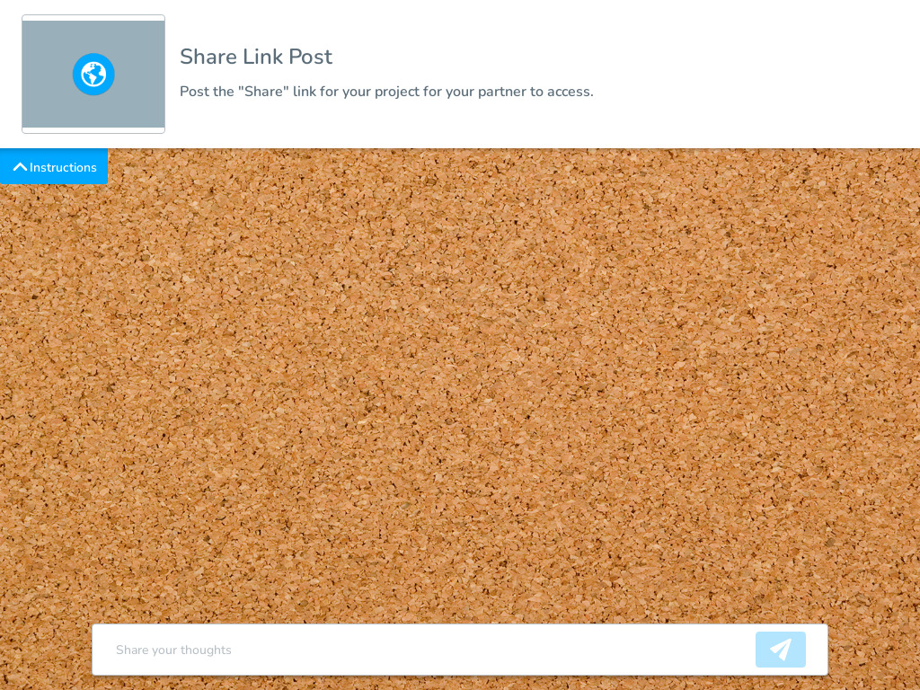

Slide 7
